Slide 1

Predicting Recurrence of Breast Cancer using Machine Learning Classification Algorithms.
Nandita Alva

Slide 2
Abstract
We used the Ljubljana Breast Cancer Data Set with 286 instances of real patient data. The data set is publicly available from UCI repository.
Using this dataset we trained several (supervised) machine learning classification algorithms to classify patient cases into 2 distinct classes, ie. Cancer Recurrence Events vs Non Recurrence Events. Where Recurrence is defined as the reappearance of cancer after at least 1 year of remission since the treatment of the primary incidence of cancer.
On testing the model accuracy of each algorithm, we found the Regression Classifier and the Gaussian Naïve Bayes Classifiers had the highest accuracy at 73%.
We recognise this accuracy level is fairly low for the model to be used reliably in a clinical setting and have identified several limitations within the dataset, which if addressed would improve the model accuracy.

Slide 3
Motivation
Breast Cancer affects close to 2 million women globally every year and is a leading cause of death. Fortunately with advancements in treatments and diagnostic ability, early detection of Breast Cancer allows physicians to treat the disease aggressively giving women a better chance of survival.
Often following the diagnosis and treatment of the primary incidence of breast cancer, recurrence events are seen. A recurrence event is characterised by the cancer “coming back” after at least a year of remission either locally (in the same organ), regionally(in a close-by organ) or distant (in another part of the body). Early detection of recurrence events (i.e. while still asymptomatic) is more likely to be curable rather than when a women seeks treatments after the cancer symptoms are seen again.
Breast Cancer follow-up care involves a multi-disciplinary approach requiring clinicians, radiographers, surgeons. The current model of care is retrospective, time consuming and expensive. Surveillance methods like Mammography, PET, Breast MRI, Ultrasound are expensive and their efficacy is as yet clinically unproven via randomised controlled trials and hence their use is reserved for symptomatic patients with highest risk of recurrence. The main model of care involves patients regularly meeting with an oncologist to identify new symptoms or changes on a physical exam. This ‘traditional’ method of diagnosis can often be retrospective as recurrence events are picked up after symptoms reoccur leading to poorer outcomes.
Machine Learning techniques can be used to identify women at risk of a recurrence using gynechalogical metrics and other cancer features. This method is cost effective, can be used to proactively identify woman at high risk of cancer recurrence(before the disease progresses to show symptoms) and tailor treatments for women to improve chances of survival.

Slide 4
Dataset(s)
We use the Ljubljana Breast Cancer Data Set with 286 instances of real patient data. The data set is available from UCI repository (http://archive.ics.uci.edu/ml/datasets/Breast+Cancer) and contains the following variables:
1.Age: age (in years at last birthday) of the patient at the time of diagnosis;
2. Menopause: whether the patient is pre- or postmenopausal at time of diagnosis;
3. Tumor size: the greatest diameter (in mm) of the excised tumor;
4. Inv-nodes: the number (range 0 - 39) of axillary lymph nodes that contain metastatic breast cancer visible on histological examination;
5. Node caps: if the cancer does metastasise to a lymph node, although outside the original site of the tumor it may remain “contained” by the capsule of the lymph node. However, over time, and with more aggressive disease, the tumor may replace the lymph node and then penetrate the capsule, allowing it to invade the surrounding tissues;
6. Degree of malignancy: the histological grade (range 1-3) of the tumor. Tumors that are grade 1 predominantly consist of cells that, while neoplastic, retain many of their usual characteristics. Grade 3 tumors predominately consist of cells that are highly abnormal;
7. Breast: breast cancer may obviously occur in either breast;
8. Breast quadrant: the breast may be divided into four quadrants, using the nipple as a central point;
9. Irradiation: radiation therapy is a treatment that uses high-energy x-rays to destroy cancer cells.
These variables were used to classify the dataset into two classes: Recurrence Events and No-Recurrence Events.

Slide 5

Data Preparation and Cleaning
Null Values or Erroneous Data:
The dataset contained no null values.
There was a disproportionate number of cases showing right-breast quadrants affected by cancer (expecting roughly 50:50 split). On investigation, we found that breast-quadrants were incorrectly assigned to “right” even though the left breast was impacted. However this incorrect assignment didn’t affect the quality of the classification model.
Data Cleaning & Preparation:
Most variables in the dataset were provided as strings and had to be converted to a numeric representation for analysis.
Age, Tumor Nodes & Tumor Size were presented in ranges eg. (24-29) etc. I took the numerical median of these ranges. While this simplified the analysis, it under-represented higher values in the range and their impact on the classification task. This bias would decrease the quality of the model as we expect larger number and sizes of the tumour and higher ages to be strong risk factors to the recurrence of breast cancer.
Other variables e.g. Irradiation, Breast, Breast-quadrant, menopause, degree of malignancy, presence of node caps (Y/N) were either binarized (in case of 2 variables) or were provided distinct numerical variables to categorize them numerically.

Slide 6
Research Question(s)
Based on the input variables listed in the dataset slide, we aim to build a classification model to classify patient data into 2 classes:
Recurrence Events
Non-Recurrence Events
A recurrence event is characterised by the cancer “coming back” after at least a year of remission. This reappearance can be either locally (in the same organ), regionally(in a close-by organ) or distant (in another part of the body).
Early detection of recurrence events (i.e. while still asymptomatic) is more likely to be curable rather than when a women seeks treatments after the cancer symptoms are seen again. Thus this classification task has high clinical significance and can be used to complement the traditional model of care.

Slide 7
Methods
Split the Dataset:
- Training
-Testing
Build the Model
Predict
Calculate Accuracy

Slide 8
Methods
1.The dataset was split into a training set and a testing set using the command: train_test_split(features, Output, test_size = 0.73, random_state = 324). Given such a small data set (285 cases, I chose to train on 73% of the data to gain accuracy).
2. I investigated various classification algorithms to find the best model. These are as below:
#1. DecisionTreeClassifier(max_leaf_nodes=19, random_state=0)
#2. LogisticRegression(random_state = 0)
#3. KNeighborsClassifier(n_neighbors = 3, metric = 'minkowski', p = 2)
#4. SupportVectorClassifier(kernel = 'linear', random_state = 0)
#5. GaussianNaiveBayes()
#6. RandomForestClassifier(n_estimators = 10, criterion = 'entropy', random_state = 0)
3. I used the classifier object to predict the class on the test slice of the dataset using recurrence_classifier.predict(features_test)
4. Finally I calculated the accuracy of each algorithm in classifying our test set using: accuracy_score(y_true = Output_test, y_pred = ModelPredictions)

Slide 9
FINDINGS

Slide 10
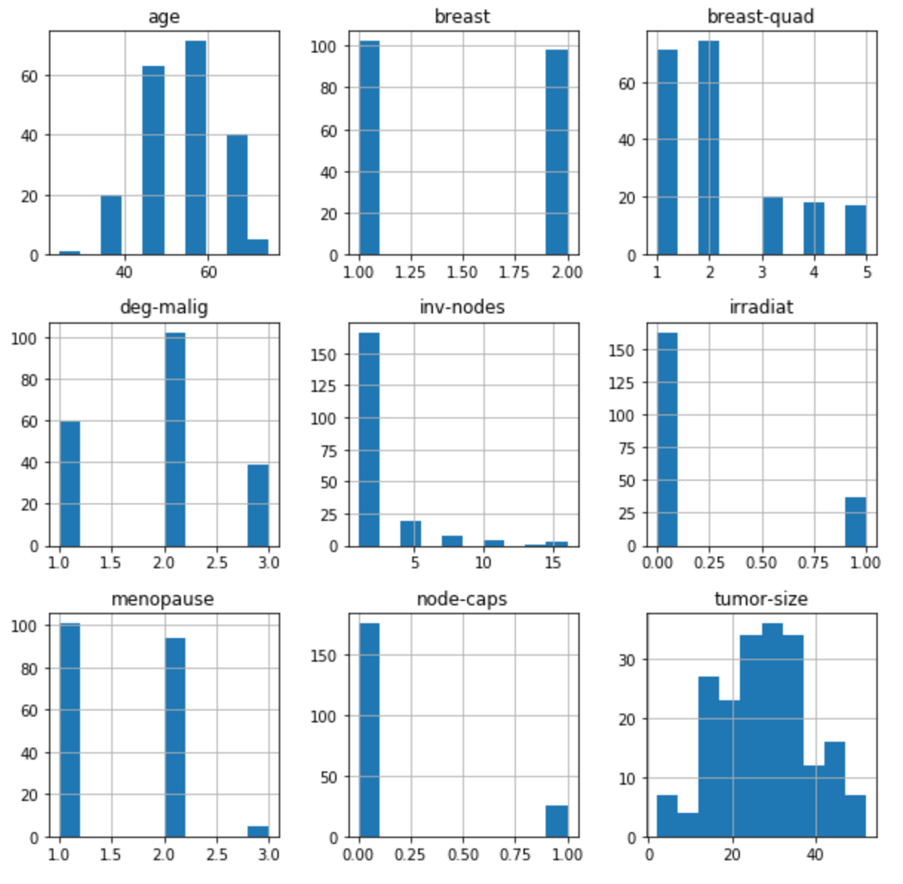
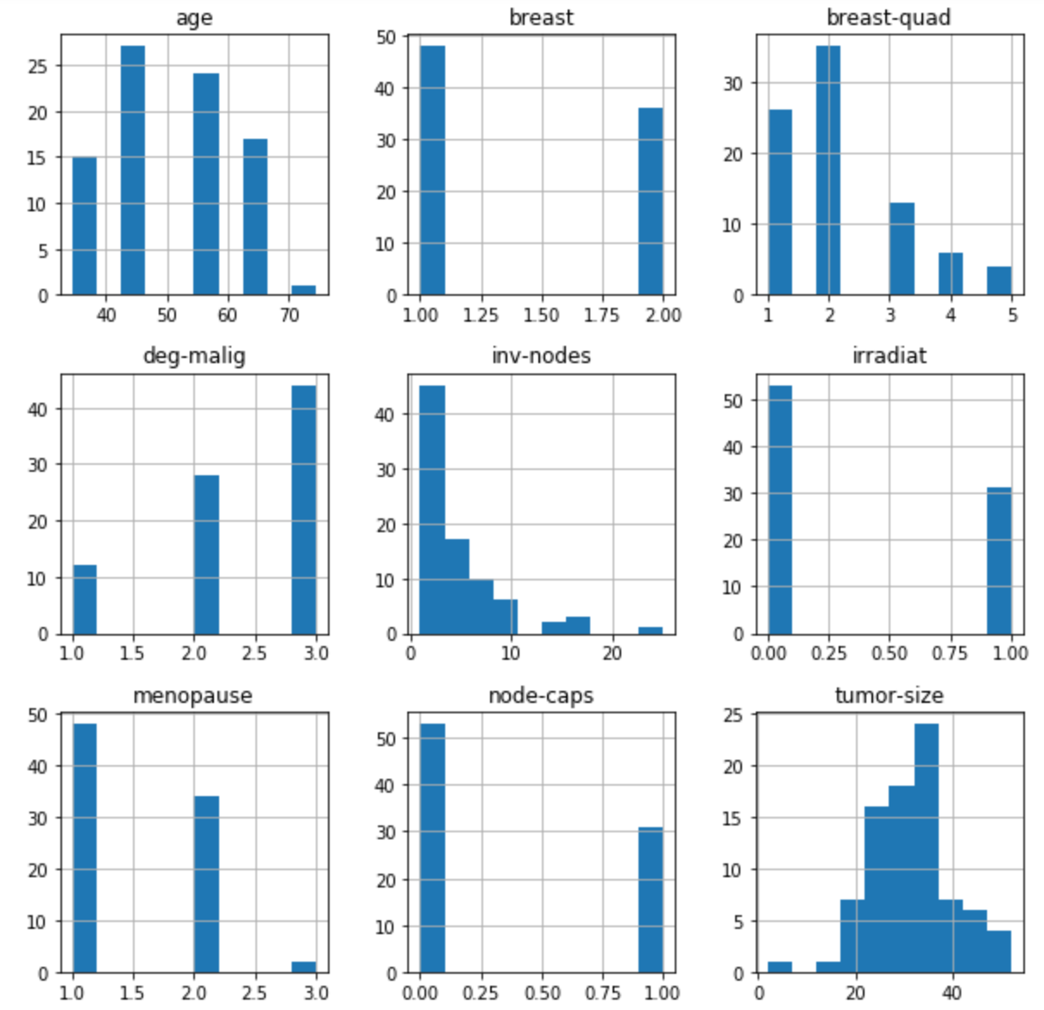
Characteristics for Recurrent Vs Non-Recurrent Breast Cancer Cases
No Recurrence Events
Recurrence Events

Slide 11
Model Prediction Accuracy
I calculated the accuracy of various models in predicting Breast Cancer Recurrence based on the 9 Input Variables. Logistic Regression and Gaussian Naïve Bayes were the best performing Algorithms.
#1.Decscion Tree Classifier: 64.27%
#2.Logistic Regression: 73.17%
#3.KNearest Neighbour: 67.54%%
#4.Support Vector Machine Model (SVC): 70%
#5.Gaussian Naive Bayes Algorithm: 73.17%
#6.Random Forest Classifier: 70.21%
However, at 73% the model accuracy is lower than what would be required to reliably apply these models in a clinical setting. I will address the limitations of the dataset and make recommendations for improving the accuracy score in the next slide on Limitations.

Slide 12
Limitations
Limitations of Current DataSet:
The Dataset used is relatively small 286 cases, of which 201 are instances of one class (no-recurrence) and 85 are instances of the other (recurrence events). Given this disproportionate distribution of the two classes within a small dataset, the model may bias predictions towards the more dominant no-recurrence class.
The Woman's’ age & the Number & Size of the tumor need to be provided in distinct numeric values instead of as a range as the model looses valuable granularity of these input variables.
Additional Data Required:
The dataset doesn’t include all risk factors to cancer recurrence ie. Family history or breast cancer, Genetic Mutations (BRCA1 & BRCA2). Availability of these metrics would improve the prediction accuracy score.
The dataset doesn’t contain details about the cancer cell nuclei: eg. (radius, perimeter, area, texture, smoothness, compactness, concavity, symmetry etc).

Slide 13
Conclusions
Machine Learning algorithms can be used to supplement the existing model of care for the early detection of Breast Cancer Recurrence Events. Given these algorithms require analytical input variables & don’t rely on actual cancer symptoms, they can be used to improve patient survival outcomes at the population level in a more cost-effective manner.
Of the various Machine Learning Algorithms investigated, the Regression Classifier and the Gaussian Naïve Bayes models had the best accuracy in predicting Recurrence Events (Class 1) vs No-Recurrence Events (class 2).
Unfortunately due to the limitations identified in the dataset the maximum model prediction accuracy of 73% necessitates more work to be done before this model can be confidently used in a clinical setting. The risk with such a low accuracy score is the number of false positives (women with potential recurrence events that test negative) that may go undetected.

Slide 14
Acknowledgements
This breast cancer domain was obtained from the University Medical Centre, Institute of Oncology, Ljubljana, Yugoslavia. Thanks go to M. Zwitter and M. Soklic for providing the data. It is available online here.
In addition I would like to acknowledge work done by Vishabh Goel in building a simple machine learning model to predict breast cancer on a different dataset. His work provided inspiration for my project.

Slide 15
References
Current Approaches and Challenges in the Early Detection of Breast Cancer Recurrence. Journal of Cancer. March 2016.
American Cancer Society.
Breast cancer diagnostic typologies by grade-of-membership fuzzy modelling. Proceedings of the 2nd WSEAS International Conference on Multivariate Analysis and its Application in Science and Engineering .University of Lisbon,2009.
UCI Centre for Machine Learning and Intelligence Systems. Breast Cancer Data Set.

